Slide 1
Spring framework, Spring MVC, Spring Boot, Thymleaf, Dependency injection, Hibernate, JPA
Understand what is Spring framework
Understand the roles of Spring MVC and Spring Boot
Understand various spring annotations
Understand how to serve dynamic web pages using thymleaf template engine
Understand spring dependency injection and IOC container
Understand what is Hibernate and why it is used for ORM
Understand various types of relationship mappings

Slide 2
Spring Framework
What is Spring framework ? :- the spring framework was developed in 2003 by Rod Johnson, it is an open-source framework for the java platform. It provides comprehensive infrastructure support for developing java applications. Spring aims to make java development easier by promoting good design practices such as modularity, loose coupling, and dependency injection. Spring is known as the framework of frameworks because it provides supports to various frameworks. The spring framework comprises several modules such as IOC, AOP, DAO, ORM, MVC etc. Let's understand IOC and Dependency injection.
What is IOC ? :- IOC stands for inversion of control it is a design principle and a key concept in software development, particularly in framework like Spring.
In traditional programming, the flow of control is determined by the program logic and the framework and library you are using where you create objects and call methods directly on those object in your code. However, with IOC the control of flow is inverted from the programmer to the framework. Instead of the programmer explicitly creating and managing objects, the framework manages the objects and their life-cycle. The framework is responsible for creating objects, injecting dependencies and calling method on those objects. The core idea behind IOC is for decoupling components and promote loose coupling in your application which leads to more modular, maintainable and testable code.
What is Dependency Injection (DI) ? :- it is a popular technique used to implement IOC. With DI instead of objects creating their dependencies i.e (other objects they rely on) dependencies are injected into the object by an external entity, a framework or a DI container which allows the programmer to easily change dependencies, mock them for testing and manage their life-cycle. There are two ways to perform DI in spring framework by using constructor or setter method
DI is just a way for us to inject and use the features of one class in another class.
In summary IOC is a design principle that promotes loose coupling and modular design by inverting control of object creation and life-cycle management from the programmer to the framework or container. While DI is a common technique used to implement IOC.

Slide 3
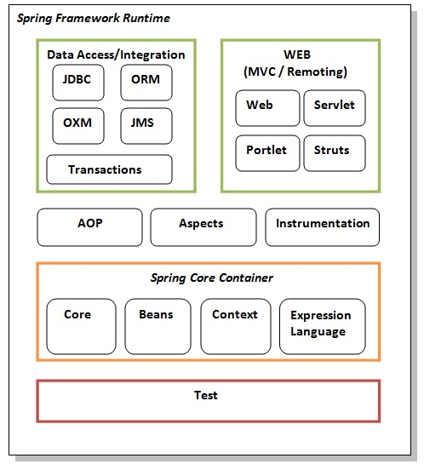
Advantages of spring framework :
1. predefined template :- spring framework provides template for JDBC, Hibernate, JPA technologies. So, there is no need to write to many code, it hides the basic steps of this technologies. For instance, using JDBCTemplate were we have to write code for exception handling, create connection, create statement, committing transaction and closing transaction, with spring framework we don't have to do that anymore, all we have to do is write query while spring take cares of the other stuffs underneath the hood which helps save a lot of JDBC code.
2. Loose coupling :- the spring application are loosely coupled because of dependency injection.
3. Easy to test :- the dependency injection makes it easier to test the application.
4. Fast development of application :- Spring support to various framework makes it easy to develop java EE applications.
5. Declarative support :- it provides a declarative support for caching, validation, transactions and formatting.
Spring modules :- the spring framework consists of many modules such as core, beans, AOP, WEB etc

Slide 4
Hibernate
What is hibernate? :- hibernate is an open-source Object Relational Mapping (ORM) tool for java. It provides a framework for mapping java objects to database and vice-versa. Hibernate framework aim to simplify the development of database driven application by abstracting away the details of SQL queries and database interactions, which allow the developers to focus on working with objects instead of raw SQL. Hibernate implements the specification of JPA (Java Persistence API) for data persistence.
Before we continue with Hibernate, let's have a brief understanding of what is ORM and JPA?
What is ORM tool? :- ORM tool simplifies data creation, data manipulation and data access. It is a programming technique that maps the object to the data store in the database. Underneath the hood ORM uses JDBC API to interact with the database.
What is JPA ? Stands for Java Persistence Api – it is a java specification that provides certain functionality for managing relational data in java applications. JPA provides a standardized way for Java developers to interact with relational databases using object-oriented principles.
Key features and components of JPA includes:
1. Object Relational Mapping : JPA allows developers to map java objects to relational database tables and vice-versa. This mapping is usually done using annotations or XML configurations.
2. Entity Management : JPA provides APIs for managing persistent entities(Objects that are stored in the database) it supports CRUD operations on entities and provides mechanism for loading, persisting, updating and deleting entities.
3. Entity Relationships : JPA support defining relationship between entities such as one-to-one, one-to-many, many-to-one and many-to-many relationships. This relationships are mapped using annotations.
4. integration with Java EE and Spring : JPA can be integrated with Java EE and Spring frameworks to build enterprise grade applications for Spring frameworks like MVC, spring boot JPA is integrated through the spring data jpa dependency.

Slide 5
Why use Hibernate ? :- 1. open-source and lightweight --- hibernate is an open-source lightweight framework which means there is continuous update on it.
2. fast performance -- performance in hibernate is fast because cache is internally used. 3. database independent query -- hibernate uses HQL which is the object-oriented version of SQL to generate independent queries so you as the developer don't need to write database specific queries. 4. automatic table creation -- hibernate framework provides the facility to create the tables of the database automatically, so there is no more need for manually creating database table.
Hibernate using annotation :- hibernate application can be created with annotation such as @Entity, @Id, @Table etc.
Class activity 1A – let's see how to bootstrap a simple spring boot application and create an Employee table with column fields and connect it to a database in mysql using hibernate/jpa.
Class exercise 1 -- practice class activity 1A from scratch
Let’s briefly understand the various entity relationships :
what is One-to-Many relationship? -- in Object Relational Mapping (ORM) -- a One-to-Many relationship is a type of relationship where one entity or object is associated with multiple instances of another entity.
Let's give a breakdown of the One-to-Many relationship :
1. Definition :- in a One-to-Many relationship each instance of the one entity is associated with one or more instances of the many entity. E.g consider a scenario where each customer can have multiple orders. Here each customer (one) can be associated with multiple orders (many).
2. Database Representation :- in a relational database, a one-to-many relationship is typically implemented using foreign keys. In the example of customers and orders, the order table will contain a foreign key that references the primary key of the customer table. This foreign key established the link between orders and customers. Which indicates that each other belongs to one customer.

Slide 6
3. Object Relational Mapping :- when working with an ORM framework like hibernate in java, one-to-many relationships are represented using object associations, in hibernate you will define a one-to-many relationship using annotations.
4. Navigating the relationship :- in a one-to-many relationship, you can navigate from the one side to the many side, but not necessarily vice versa. E.g. given a customer object, you can easily access all orders associated with that customers. However, given an order object you may not have direct access to the customer object it belongs to(though this can be achieved with bi-directional mapping)
5. Cascade Operations: In some ORM frameworks, such as Hibernate, cascade operations can be configured for one-to-many relationships. This means that certain operations performed on the "one" side (e.g., saving or deleting a customer) can automatically cascade to related entities on the "many" side (e.g., saving or deleting associated orders).
Class activity 2A : let's see an example of how to implement a one-to-many relationship using annotation between Employee and Department, where one Department can have many Employees, and many Employees can only belong to one Department
Class exercise : practice class activity 2A
what is many-to-many relationship :- many-to-many relationship represents an association between two entities where each instance of one entity can be associated with multiple instances of the other entity, and vice versa. This type of relationship typically requires an intermediate join table to store the associations between the two entities.
Here is a breakdown of many-to-many relationship:
Definition :- in a many-to-many relationship, each record in Table A can be related to multiple records in Table B.
Join table :- to represent a many-to-many relationship in a relational database, you need a third table known as the join table or linking table. This table typically contains foreign key references to the primary keys of both table involved in the relationship
Lazy Loading: Hibernate supports lazy loading for many-to-many associations, allowing you to load related entities only when needed to improve performance and avoid unnecessary database queries.
Class activity 3A : let's see an example of how many-to-many relationship works between Employees and Groups
Class exercise – practice class activity 3A

Slide 7
What is one-to-one relationship? a one-to-one relationship represents an association between two entities where each instance of one entity is associated with exactly one instance of the other entity. This type of relationship typically involves a primary key-foreign key association between the two entities.
Here's an overview of a one-to-one relationship in Hibernate:
1. Entities: You have two entities that are related to each other in a one-to-one relationship.
2. Foreign Key: In the database, one of the entities typically has a foreign key column that references the primary key of the other entity. This establishes the one-to-one relationship between the two tables.
3. Mapping: In Hibernate, you map the one-to-one relationship using annotations or XML mappings. You specify the association between the two entities and define the foreign key column.
4.Cascade Operations: Hibernate allows you to configure cascade operations for the one-to-one relationship. This means that certain operations performed on one side of the relationship (such as saving or deleting an entity) can cascade to the other side.
5. Hibernate supports lazy loading for one-to-one associations, allowing you to load related entities only when needed to improve performance and avoid unnecessary database queries.

Slide 8
Spring MVC
What is Spring MVC ? :- Spring MVC (Model-View-Controller) is a framework within the larger Spring Framework for building web applications in Java. It follows the MVC design pattern, which separates an application into three main components:
Model: Represents the data and business logic of the application. It encapsulates the application's data and state.
View: Represents the presentation layer of the application. It is responsible for rendering the user interface based on the data provided by the model.
Controller: Acts as an intermediary between the model and the view. It handles user input, processes requests, and updates the model accordingly. It also determines which view to render based on the request.
Spring MVC provides a robust and flexible architecture for developing web applications. It offers features such as:
DispatcherServlet: The central servlet that receives incoming requests and dispatches them to the appropriate controllers.
HandlerMapping: Maps incoming requests to appropriate handler methods within controllers based on URL patterns.
ViewResolver: Resolves logical view names returned by controller methods to actual view implementations (such as JSP, Thymeleaf, or HTML templates).
Data Binding: Automatically binds request parameters to Java objects, simplifying form handling and validation.
Interceptors: Allows pre-processing and post-processing of requests before and after they are handled by controllers.
Internationalization and Localization: Supports localization of messages and views to serve applications in multiple languages.
Validation: Provides support for validating form input using validator classes.
RESTful Web Services Support: Supports building RESTful web services using annotations and HTTP methods.
Overall, Spring MVC simplifies the development of web applications by providing a structured approach to handling HTTP requests, managing application state, and rendering views. It promotes separation of concerns, making applications easier to understand, maintain, and test.

Slide 9
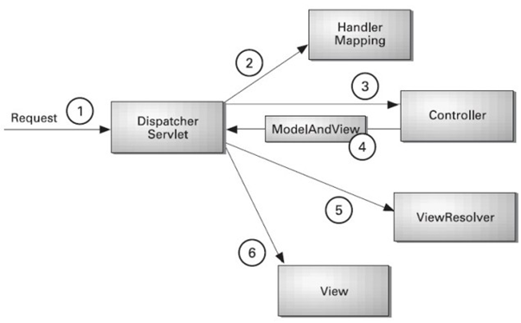
Understanding the flow of spring web MVC

Slide 10
What is the Spring MVC Model interface :- In Spring MVC, the model interface serves as a container for the data that is to be displayed in the view. It acts as a bridge between the controller and the view, allowing the controller to pass data to the view for rendering.
The primary interface used for modeling data in Spring MVC is the Model interface. This interface provides methods for adding attributes to the model, which can then be accessed by the view to render dynamic content.
Here's a brief overview of how the Model interface works:
Adding Attributes: In the controller, you can add attributes to the model using methods provided by the Model interface, such as addAttribute(). These attributes represent the data that you want to pass to the view.
Accessing Attributes in the View: In the view (e.g., a JSP page or a Thymeleaf template), you can access the attributes added to the model using expression language (EL) or Thymeleaf syntax. This allows you to dynamically render the data in the HTML output.
Displaying Data: The view renders the data received from the model, generating the final HTML response that
Before we see an elaborated example of how to implement spring MVC, let's try to understand Thymeleaf
What is Thymeleaf ? : Thymeleaf is a modern server-side Java template engine for web and standalone environments. It is designed to be a natural fit for Spring Framework-based applications and works seamlessly with Spring MVC.
Thymeleaf allows you to create dynamic web pages by blending HTML, CSS, and JavaScript with server-side data. It uses natural templates, meaning that the templates can be opened and displayed in a web browser without the need for a server to process them first unlike JSP, making development and debugging easier.

Slide 11
Here are some key features and concepts of Thymeleaf:
Natural Templates: Thymeleaf templates are regular HTML files that can be opened and edited in any text editor or web browser. This makes it easy for web designers and developers to collaborate on the same templates.
Template Expression Language (Thymeleaf-EL): Thymeleaf provides its own expression language (Thymeleaf-EL), which allows you to access and manipulate server-side data in your templates. It supports various expressions for accessing variables, iteration, conditionals, and more.
Template Fragments: Thymeleaf allows you to define reusable template fragments, such as headers, footers, or navigation bars, and include them in multiple templates using fragment expressions.
Internationalization (i18n) and Message Resolution: Thymeleaf provides built-in support for internationalization and message resolution, allowing you to easily create multilingual web applications.
Spring Integration: Thymeleaf is tightly integrated with the Spring Framework and provides several Spring-specific features, such as Spring Expression Language (SpEL) integration, Spring Security integration, and Spring MVC support.
Layout Dialect: Thymeleaf offers a Layout Dialect, which simplifies the creation of consistent layouts across multiple pages by allowing you to define layout templates and apply them to multiple pages.
Compatibility: Thymeleaf is compatible with HTML5, XHTML, and HTML4, and it supports both server-side and client-side rendering.
Overall, Thymeleaf is a powerful and flexible template engine that simplifies the development of dynamic web applications in Java, especially when used in conjunction with the Spring Framework. It is widely used in the Java ecosystem and is known for its ease of use, performance, and robust feature set.
Class activity 4A – let's create a simple student portal C.R.U.D application using Spring MVC and Thymeleaf
Class exercise – practice! Practice!! Practice!!!

Slide 12
Spring Boot
What is Spring Boot ? :- Spring Boot is an open-source Java-based framework developed by Pivotal Team. It is built on top of the Spring Framework and provides a simplified and convention-over-configuration approach to building production-ready applications. Spring Boot aims to make it easy to create stand-alone, production-grade Spring-based applications with minimal setup and configuration.
In short, Spring Boot is the combination of Spring Framework and Embedded Servers.
Why should we use Spring Boot framework?
1. The dependency injection approach is used in Spring Boot.
2. It contains powerful database transaction management capabilities.
3. It simplifies integration with other Java frameworks like JPA/Hibernate ORM, Struts, etc.
4. It reduces the cost and development time of the application.
5. Embedded Servers: Spring Boot includes embedded servlet containers (like Tomcat, Jetty, or Undertow) that allow you to run the application as a stand-alone JAR file without requiring a separate application server installation.
6. Production-Ready Features: Spring Boot provides built-in support for various production-ready features such as metrics, health checks, externalized configuration, logging, and monitoring. These features help developers build robust and maintainable applications suitable for deployment in production environments.
7. Actuator: Spring Boot Actuator is a sub-project that provides production-ready features for monitoring and managing Spring Boot applications. It includes endpoints for health checks, metrics, environment information, logging, etc., which can be exposed over HTTP or JMX.

Slide 13
Spring Boot Features
Web Development
SpringApplication
Application events and listeners
Admin features
Externalized Configuration
Properties Files
YAML Support
Type-safe Configuration
Logging
Security
Web Development : It is a well-suited Spring module for web application development. We can easily create a self-contained HTTP application that uses embedded servers like Tomcat, Jetty, or Undertow. We can use the spring-boot-starter-web module to start and run the application quickly.

Slide 14
SpringApplication : The SpringApplication is a class that provides a convenient way to bootstrap a Spring application. It can be started from the main method. We can call the application just by calling a static run() method.
Application Events and Listeners : Spring Boot uses events to handle the variety of tasks. It allows us to create factories file that is used to add listeners. We can refer it to using the ApplicationListener key.
Properties Files : Spring Boot provides a rich set of Application Properties. So, we can use that in the properties file of our project. The properties file is used to set properties like server-port =8082 and many others. It helps to organize application properties.
Security : Spring Boot applications are spring bases web applications. So, it is secure by default with basic authentication on all HTTP endpoints. A rich set of Endpoints is available to develop a secure Spring Boot application.

Slide 15
Spring vs. Spring MVC vs. Spring Boot
Spring vs. Spring Boot
Spring: Spring Framework is the most popular application development framework of Java. The main feature of the Spring Framework is dependency Injection or Inversion of Control (IoC). With the help of Spring Framework, we can develop a loosely coupled application. It is better to use if application type or characteristics are purely defined.
Spring Boot: Spring Boot is a module of Spring Framework. It allows us to build a stand-alone application with minimal or zero configurations. It is better to use if we want to develop a simple Spring-based application or RESTful services.
The primary comparison between Spring and Spring Boot are discussed below:
Spring Framework -- is a widely used Java EE framework for building applications.
Spring Boot Framework I-- s widely used to develop REST APIs.
Spring Framework -- it aims to simplify Java EE development that makes developers more productive.
Spring Boot -- It aims to shorten the code length and provide the easiest way to develop Web Applications.
Spring Framework -- The primary feature of the Spring Framework is dependency injection.
Spring Boot -- The primary feature of Spring Boot is Autoconfiguration. It automatically configures the classes based on the requirement.
Spring Framework -- The developer writes a lot of code (boilerplate code) to do the minimal task.
Spring Boot -- It reduces boilerplate code.
Spring Framework -- To test the Spring project, we need to set up the sever explicitly.
Spring Boot -- Spring Boot offers embedded server such as Jetty and Tomcat, etc.
Spring Framework -- Developers manually define dependencies for the Spring project in pom.xml.
Spring Boot -- Spring Boot comes with the concept of starter in pom.xml file that internally takes care of downloading the dependencies JARs based on Spring Boot Requirement.

Slide 16
Spring Boot vs. Spring MVC
Spring MVC: Spring MVC is a Web MVC Framework for building web applications. It contains a lot of configuration files for various capabilities. It is an HTTP oriented web application development framework.
Spring Boot and Spring MVC exist for different purposes. The primary comparison between Spring Boot and Spring MVC are discussed below:
Spring Boot : is a module of Spring for packaging the Spring-based application with sensible defaults.
Spring MVC : is a model view controller-based web framework under the Spring framework.
Spring Boot : It provides default configurations to build Spring-powered framework.
Spring MVC : It provides ready to use features for building a web application.
Spring Boot : There is no need to build configuration manually.
Spring MVC : It requires build configuration manually.
Spring Boot : It avoids boilerplate code and wraps dependencies together in a single unit.
Spring MVC : It specifies each dependency separately.
Spring Boot : It reduces development time and increases productivity.
Spring MVC : It takes more time to achieve the same.

Slide 17
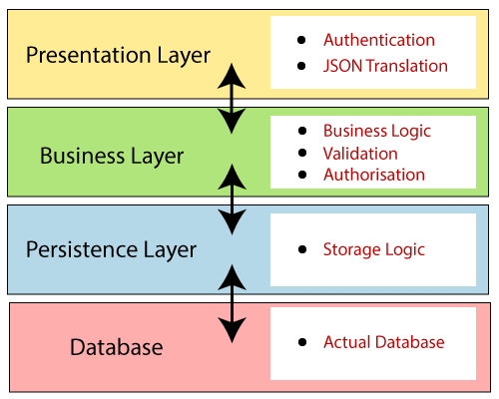
Spring Boot Architecture
Spring Boot is a module of the Spring Framework. It is used to create stand-alone, production-grade Spring Based Applications with minimum efforts. It is developed on top of the core Spring Framework.
Spring Boot follows a layered architecture in which each layer communicates with the layer directly below or above (hierarchical structure) it.
Before understanding the Spring Boot Architecture, we must know the different layers and classes present in it. There are four layers in Spring Boot as follows:
Presentation Layer
Business Layer
Persistence Layer
Database Layer

Slide 18
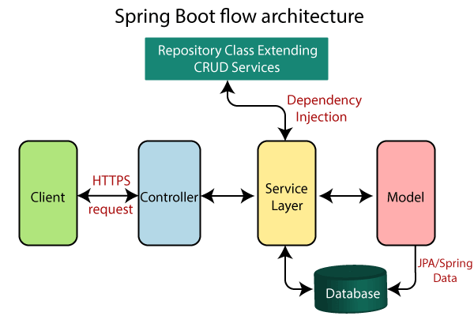
Presentation Layer: The presentation layer handles the HTTP requests, translates the JSON parameter to object, and authenticates the request and transfer it to the business layer. In short, it consists of views i.e., frontend part.
Business Layer: The business layer handles all the business logic. It consists of service classes and uses services provided by data access layers. It also performs authorization and validation.
Persistence Layer: The persistence layer contains all the storage logic and translates business objects from and to database rows.
Database Layer: In the database layer, CRUD (create, retrieve, update, delete) operations are performed.

Slide 19
Class activity 5A – let's see how to bootstrap a spring boot project using both spring initializer and the IntelliJ Ultimate IDE
Class activity 6A -- let's create a simple book-store CRUD application to allow users create, read, update and delete book
Class exercise – practice! Practice!! Practice!!!

Slide 20
Introduction to RESTful Web Services
REST stands for REpresentational State Transfer. It is developed by Roy Thomas Fielding, who also developed HTTP. The main goal of RESTful web services is to make web services more effective. RESTful web services try to define services using the different concepts that are already present in HTTP. REST is an architectural approach, not a protocol.
It does not define the standard message exchange format. We can build REST services with both XML and JSON. JSON is more popular format with REST. The key abstraction is a resource in REST. A resource can be anything. It can be accessed through a Uniform Resource Identifier (URI). For example:
The resource has representations like XML, HTML, and JSON. The current state capture by representational resource. When we request a resource, we provide the representation of the resource. The important methods of HTTP are:
GET: It reads a resource.
PUT: It updates an existing resource.
POST: It creates a new resource.
DELETE: It deletes the resource.
For example, if we want to perform the following actions in the social media application, we get the corresponding results.
POST /users: It creates a user.
GET /users/{id}: It retrieves the detail of a user.
GET /users: It retrieves the detail of all users.
DELETE /users: It deletes all users.
DELETE /users/{id}: It deletes a user.
GET /users/{id}/posts/post_id: It retrieve the detail of a specific post.
POST / users/{id}/ posts: It creates a post of the user.

Slide 21
HTTP also defines the following standard status code:
404: RESOURCE NOT FOUND
200: SUCCESS
201: CREATED
401: UNAUTHORIZED
500: SERVER ERROR
Advantages of RESTful web services
RESTful web services are platform-independent.
It can be written in any programming language and can be executed on any platform.
It provides different data format like JSON, text, HTML, and XML.
It is fast in comparison to SOAP because there is no strict specification like SOAP.
These are reusable.
They are language neutral.
THE END!!!

